Slide 1
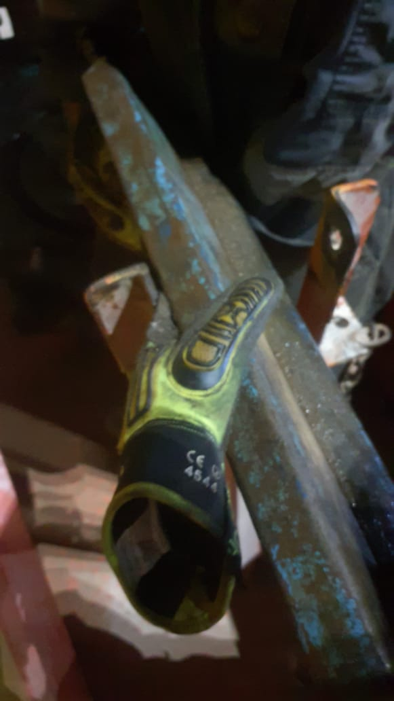
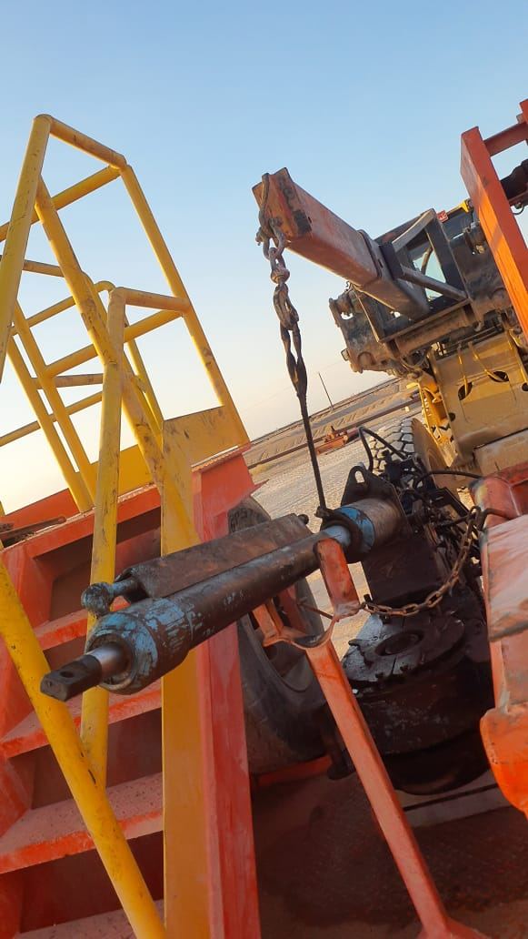
PDO Second Alert
Date: Time: | 26/10/2024 08:15 PM | Incident title: PIM# | LTI#21 1171801 | Risk Category: Injury / Asset Damaged: | Pinch Point Finger Injury | Actual Severity: Potential severity: | C3P B3P | Activity: Location: | Rig Down LEKHWAIR
Target Audience: Rig Manager & Hoist Crew
What happened?
On 26th October 2024 at 20:15, during rig move operations, the task was to rig down the power tong from the rig floor to BOP trailer using a crane. After being lowered from the rig floor, the power tong was positioned on the BOP trailer. A floorman (IP) then attempted to manually lower the power tong cylinder from a vertical to a horizontal position to secure it on the cylinder racking stand. During this process, the floorman was controlling the cylinder descending resulting in his left-hand index finger caught between the cylinder and the cylinder rack stand. Floorman was immediately taken to the PDO clinic and was subsequently transferred to Muscat hospital for further treatment, as recommended by the PDO doctor.
Why it happened/Finding :
The hydraulic cylinder cradle was designed for greater stability during transport
SOP didn’t clearly identify the utilization of Crane or Fork lift to lower the hydraulic cylinder
Floorman was working alone without supervision
Floorman was lowering the cylinder manually rather than using the mechanical aids.
Crane and forklift was available but floorman decided to lower the cylinder using his hand
There was sufficient lighting in the area
Your learning from this incident..
All supervisors to ensure effective supervision is available till the completion of any task.
All supervisors to ensure the implementation of SWA and empower the crew to stop any task when they are in doubt.
All supervisors to ensure utilization of crane/forklift to handle all the tasks to eliminate manual handling.
Rig manager to ensure pinch point is marked and pinch point register is updated.
IP finger got pinched between the cylinder and cylinder rack stand
Ensure to use forklift or crane to lower the cylinder
Always ensure to use crane and forklift to handle the heavy objects
Notes:
Ensure all dates and titles are input
A short description should be provided without mentioning names of contractors or individuals. You should include, what happened, to who (by job title) and what injuries this resulted in. Nothing more!
Four to five bullet points highlighting the main findings from the investigation. Remember the target audience is the front line staff so this should be written in simple terms in a way that everyone can understand.
The strap line should be the main point you want to get across
The images should be self explanatory, what went wrong (if you create a reconstruction please ensure you do not put people at risk) and below how it should be done.

Slide 2
Effective Learning
Date: Time: | 26/10/2024 08:15 PM | Incident title: PIM# | LTI#21 1171801 | Risk Category: Injury / Asset Damaged: | Pinch Point Finger Injury | Actual Severity: Potential severity: | C3P B3P | Activity: Location: | Rig Down LEKHWAIR
To make sure learning is translated to the site day to day activities , please answer the below questions :-
How learning can be implemented at site ?
Hoist and Drilling Supervisors to ensure mechanical aid (Forklift/Crane) is utilized to handle heavy objects.
Hoist and Drilling Supervisors to ensure direct supervision of all non-routine activities.
Hoist and Drilling Supervisors to encourage empowerment of Stop-work Authority.
HSE Advisors to train crew members in developing skills in safe handling techniques.
How can you sustain the action ?
Conduct self verification to Ensure compliance with Musta’ed 7 steps.
Use CCTV camera to verify the compliance and provide the feedback to site crews.
Table of contents
Notes:
Guideline for Effective Learning & Sustainability
•Can be replicated across similar contractor / activities
•Shall be SMART- Specific ,Measurable , Achievable ,Realistic & Timebound
•Can be implemented in a months' time

