Slide 1
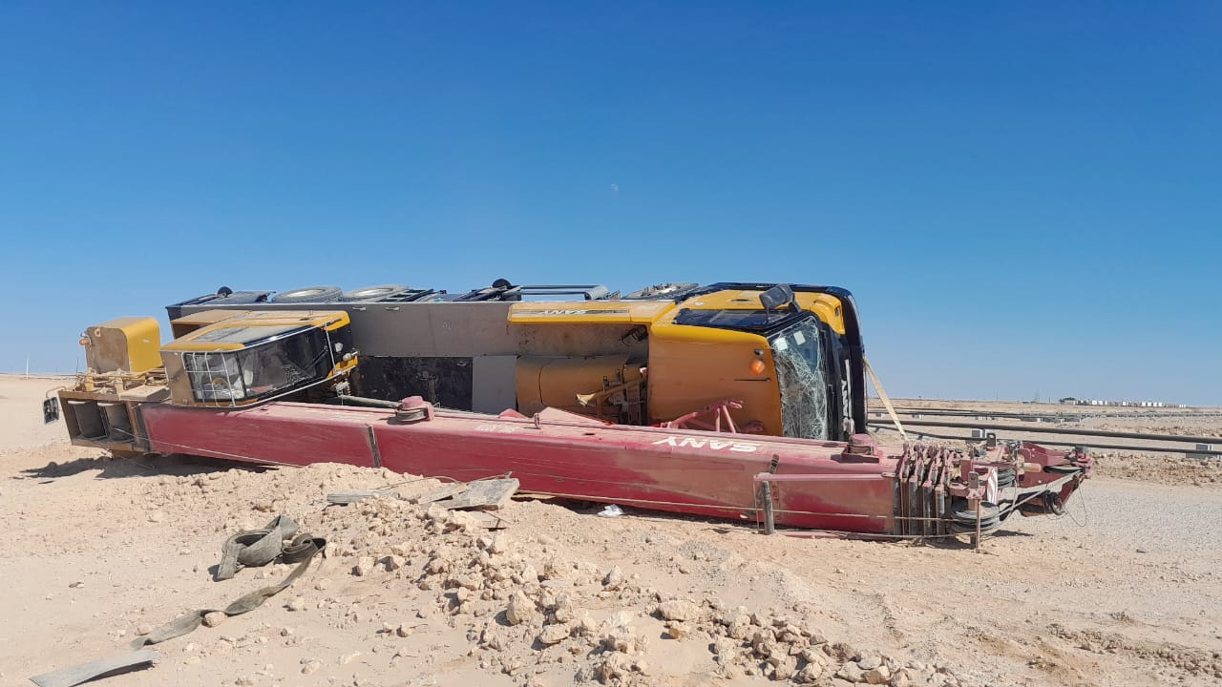
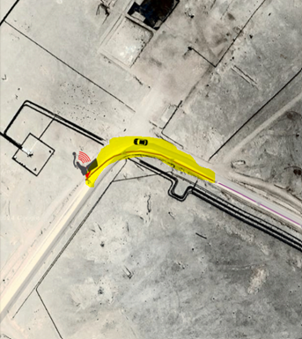
PDO Second Alert
Date: Time: | 08/01/2025 13:14 | Incident title: PIM# | HiPo#01 1173803 | Risk Category: Injury / Asset Damaged: | MVI Rollover Vehicle damage | Actual Severity: Potential severity: | 1P B4P | Activity: Location: | Driving Sadad / Bahja
Target Audience: Drilling & Well Service Operation
Photo explaining what was done wrong
What happened?
On Wednesday 8th of January at 13:14hrs, a crane operator was on route to a work location in Sadad (Bahja area) driving on a graded road traveling together with a portable tearoom transport trailer behind at a safe distance. The graded road was well compacted and even, however, the crane operator lost control while negotiating a sharp bend/curve on the road at an unsafe speed. This resulted in the crane tipping on its side. The IVMS sec-sec report shows that the crane operator was driving at a speed of 56 km/h while negotiating the curve.
No persons were injured as a result of this MVI.
Why it happened/Finding :
The crane operator was driving at an unsafe speed while negotiating a sharp bend on a graded road
The crane operator experienced delayed reaction & poor judgment underestimating the risks of negotiating such a sharp
bend at an unsafe speed.
The driver is familiar with the road and felt overconfident, leading to a false sense of security.
Lack of job commencement communication leading to the crane operator assuming that he was delaying the operation
which resulted in traveling at high speeds to arrive at the work site quicker.
Your learning from this incident..
Always adhere to the manufacturer's recommended speed limits and ensure crane operators are trained to understand the safe travel speed for various conditions.
Always perform a mental and visual risk assessment during a journey, considering the type of vehicle driven and road
conditions.
Always clearly discuss the job commencement plan with other operational support units, so they can plan their trip
accordingly, without feeling pressure to rush or take shortcuts.
Always comply with road safety standards.
Photo explaining how it should be done right
Anticipate curve & start to reduce speed accordingly
Assess and apply speed management in accordance with road conditions, vehicle type and load
Notes:
Ensure all dates and titles are input
A short description should be provided without mentioning names of contractors or individuals. You should include, what happened, to who (by job title) and what injuries this resulted in. Nothing more!
Four to five bullet points highlighting the main findings from the investigation. Remember the target audience is the front line staff so this should be written in simple terms in a way that everyone can understand.
The strap line should be the main point you want to get across
The images should be self explanatory, what went wrong (if you create a reconstruction please ensure you do not put people at risk) and below how it should be done.

Slide 2
Effective Learning
Date: Time: | 08/01/2025 13:14 | Incident title: PIM# | HiPo#01 1173803 | Risk Category: Injury / Asset Damaged: | MVI Rollover Vehicle damage | Actual Severity: Potential severity: | 1P B4P | Activity: Location: | Driving Sadad / Bahja
To make sure learning is translated to the site day to day activities , please answer the below questions :-
How learning can be implemented at site ?
By reviewing all causational factors that resulted in this incident occurring with the site team, then conduct an assurance verification audit with your drivers to identify if you have similar gaps that need to be mitigated.
By organizing regular safety awareness sessions for all drivers/crane operators, focusing specifically on the dangers of driving at unsafe speeds vs road conditions. Use real-life case studies, including examples of past incidents, to illustrate the potential risks.
On-the-Job Cross Coaching: Assign an experienced crane assessor to periodically mentor and evaluate crane operators on the contract. They can provide on-the-job guidance and ensure correct practices are being followed.
How can you sustain the action ?
Frequently assess your driver's knowledge in ability to manage assigned tasks/responsibilities safely, by performing assurance verification audits and developing mitigation plans, then monitoring for effectiveness.
Integrate safety performance metrics into the regular performance reviews for crane operators. Reward safe behaviors and provide corrective actions when necessary.
Offer refresher training sessions periodically, especially after any incidents or near misses. Keep the team updated with any changes in safety standards, technologies, or procedures related to road safety.
Notes:
Guideline for Effective Learning & Sustainability
•Can be replicated across similar contractor / activities
•Shall be SMART- Specific ,Measurable , Achievable ,Realistic & Timebound
•Can be implemented in a months' time

