Slide 1
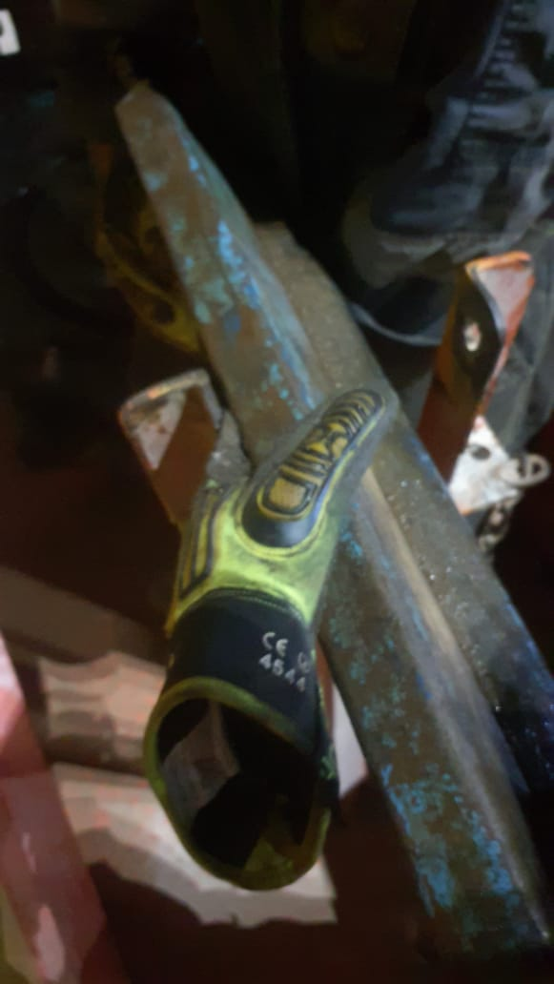
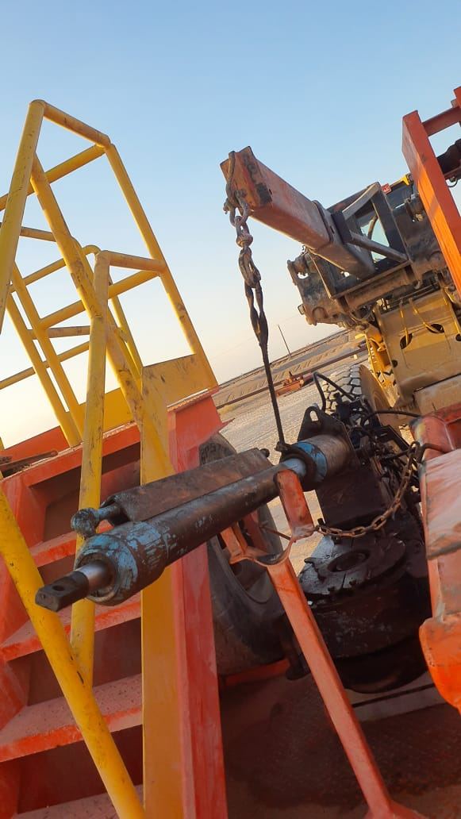
Learning From Incident - First Alert
Prevent
PIM # | 1171801 | Date & Time | 26.10.2024, 20:15 PM | Location | Lekhwair
Incident Type | LTI#21 | Category | Hands & Fingers | Activity | Rigging Down
Target Audience: All
What happened:
While rigging down the power tong from the rig floor to the chock manifold trailer using a crane, the power tong was positioned on the chock manifold trailer. The floorman attempting to manually lower the power tong cylinder from a vertical to a horizontal position in order to secure it on the cylinder racking stand. During this process, his left-hand index finger became trapped between the cylinder and the racking stand resulting Finger Injury.
Initial Findings:
During TBT, there was no proper emphasis on safest methodology of lowering the cylinder.
The floorman assumed that he can tilt down the cylinder manually.
The floorman did not identify the pinch point hazard.
Work started without direct supervision.
Reflective Engagement Questions:
How do you Identify, evaluate & control the hazards involved in the task ?
Are you aware of the manual handling & pinch points risks associated with the task?
How do you comply with right method of handling heavy material ?
How do you ensure an effective supervision is available till the completion of any task?
How do you ensure to implement Stop Work Authority (SWA) and empower the crew to stop any task when they are in doubt?
Always ensure that cranes and forklifts are used to handle heavy objects for safety and efficiency.
In case of an emergency please call PDO Emergency Number (Toll Free): 2467-5555
Notes:
Mr Musleh image on the top right will change according to incident pattern, MSE3 will provide you with the image as per the pattern
What happened: A short description should be provided without mentioning names of contractors or individuals. You should include, what happened, to who (by job title) and what injuries this resulted in. Nothing more!
Initial Finding: Four to five bullet points highlighting the initial main findings from the investigation. Remember the target audience is the front-line staff so this should be written in simple terms in a way that everyone can understand.
Learnings: Four to five learning message in the form of questionnaires linked with initial findings
The strap line should be the main learning point you want to get across
The images should be self explanatory, what went wrong (if you create a reconstruction please ensure you do not put people at risk) and below how it should be done.

