Slide 1
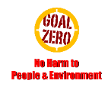
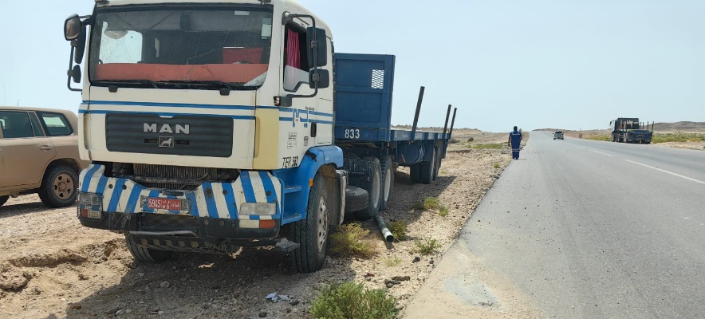
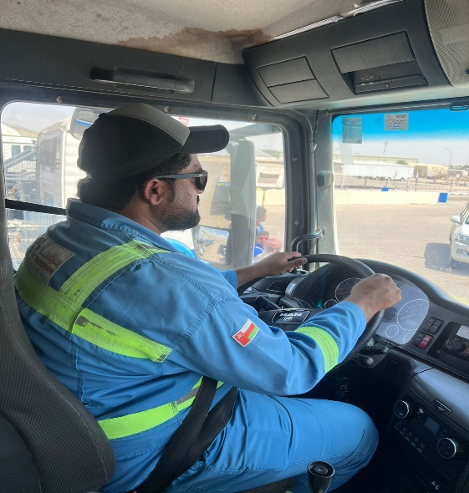
Learning From Incident - First Alert
Prevent
PIM # | 1169365 | Date & Time | 13.08.2024, 08:30 PM | Location | Fahud
Incident Type | LTI#13 | Category | Driving | Activity | Driving
Target Audience: All
What happened:
On 13 August 2024 at 08:30, While enroute from Qarn Alam to Fahud driving a truck with trailer, the driver came off the blacktop onto on to the side of the road, where his vehicle entered rough ground, he was able to control the vehicle and bring it to a stop however, immediately felt pain in his back.
He was initially taken to Fahud PDO clinic before being transferred to Nizwa hospital, where x-ray revealed simple fracture on his back.
Initial Findings:
Driver mentioned 3rd party vehicles at speed on the road
Vehicle is in ROP for inspection
Vehicle speed was high as it changed surface
Engagement Questions:
Do you carry out pre truck inspection?
Do you ensure drivers wear their seatbelts correctly?
Do you report all faults on vehicles at the end of your journey?
Do you reduce speed as road condition gets bad?
Do you report previous injuries and medical condition?
Always wear seat belt correctly
In case of an emergency please call PDO Emergency Number (Toll Free): 2467-5555
Notes:
Mr Musleh image on the top right will change according to incident pattern, MSE3 will provide you with the image as per the pattern
What happened: A short description should be provided without mentioning names of contractors or individuals. You should include, what happened, to who (by job title) and what injuries this resulted in. Nothing more!
Initial Finding: Four to five bullet points highlighting the initial main findings from the investigation. Remember the target audience is the front-line staff so this should be written in simple terms in a way that everyone can understand.
Learnings: Four to five learning message in the form of questionnaires linked with initial findings
The strap line should be the main learning point you want to get across
The images should be self explanatory, what went wrong (if you create a reconstruction please ensure you do not put people at risk) and below how it should be done.

