Slide 1
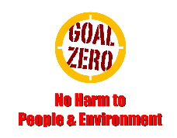
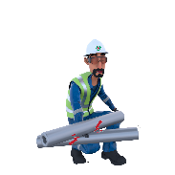
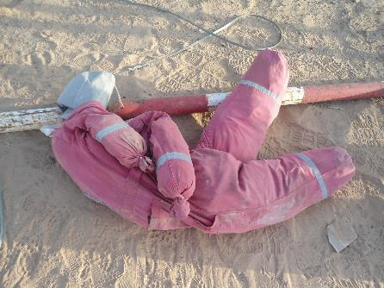
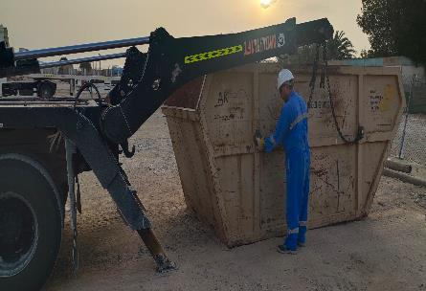
Learning From Incident - First Alert
Prevent
PIM # | 1169222 | Date & Time | 11.08.2024, 13:30 PM | Location | Qarn Alam
Incident Type | LTI#12 | Category | Drops (Dropped pipe) | Activity | Replacing waste skip
Target Audience: All
What happened:
On 11 August 2024 at 13:30, the waste truck crew, comprising the driver and a helper, encountered an incident. After the helper had secured the chains on top of the skip, he attempted to exit by going under the barrier. During this process, he made contact with the barrier, causing it to fall and strike his jaw.
Initial Findings:
Waste transportation crew did not report to security and did not receive site safety induction.
Lack a Standard Operating Procedure (SOP) for this activity.
Lack of intervention by the crew.
Failure to seek assistance when needed
Engagement Questions:
Do you plan your actions and determine the necessary steps to work safely and avoid the line of fire?
What measures do you take to ensure you are not distracted at work?
Do you provide feedback to supervisors on SOPs for improvement?
Do you understand Line of Fire?
ALWAYS avoid the line of fire!
In case of an emergency please call PDO Emergency Number (Toll Free): 2467-5555
Notes:
Mr Musleh image on the top right will change according to incident pattern, MSE3 will provide you with the image as per the pattern
What happened: A short description should be provided without mentioning names of contractors or individuals. You should include, what happened, to who (by job title) and what injuries this resulted in. Nothing more!
Initial Finding: Four to five bullet points highlighting the initial main findings from the investigation. Remember the target audience is the front-line staff so this should be written in simple terms in a way that everyone can understand.
Learnings: Four to five learning message in the form of questionnaires linked with initial findings
The strap line should be the main learning point you want to get across
The images should be self explanatory, what went wrong (if you create a reconstruction please ensure you do not put people at risk) and below how it should be done.

