Slide 1
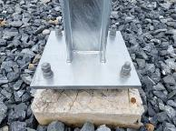

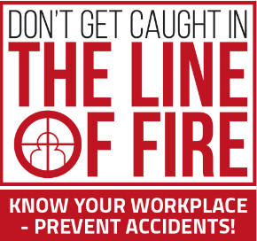
PDO Second Alert
Date: Time: | 10/08/2024 06:20 PM | Incident title: PIM# | LTI#11 1169216 | Risk Category: Injury / Asset Damaged: | Crash between Finger Injury | Actual Severity: Potential severity: | 3P C3P | Activity: Location: | Structure erection LEKHWAIR
Target Audience: Drilling, Logistics, Operation & Construction
What happened?
On 10.08.2024 at 18:20 during the erection of vent stack, a mechanical crew were trying to align the structure with the base plate's bolts. A Mechanical Fitter was holding a wooden piece underneath the base plate to align with one of the bolts while another crew member was hammering the wooden piece to align the bolt with the hole. Unfortunately, the Mechanical Fitter placed his fingers in the line of fire under the wooden piece, which he was holding in position, resulting in a finger crush injury on the right-hand ring and little finger when the vent stack was seated.
Why it happened/Finding:
The worker was heavily focused on completing the task, not realizing his hand was in the line of fire.
The correct method for re-aligning the bolts and base plate holes was not followed.
Lack of the intervention by the crew.
Your learning from this incident.
Do you look for possible pinch points before you start a task?
Do you plan your actions and determine the necessary steps to work safely and avoid the line of fire?
What measures do you take to ensure you are not distracted at work – many accidents occur you are not giving your full attention to the task?
Do you engage in any work task when you place hands or fingers where you cannot see them. What precautions do you take to avoid this?
Be aware of your hand positions and ALWAYS avoid the line of fire!
Notes:
Ensure all dates and titles are input
A short description should be provided without mentioning names of contractors or individuals. You should include, what happened, to who (by job title) and what injuries this resulted in. Nothing more!
Four to five bullet points highlighting the main findings from the investigation. Remember the target audience is the front line staff so this should be written in simple terms in a way that everyone can understand.
The strap line should be the main point you want to get across
The images should be self explanatory, what went wrong (if you create a reconstruction please ensure you do not put people at risk) and below how it should be done.

Slide 2
Management self-audit
Date: Time: | 10/08/2024 06:20 PM | Incident title: PIM# | LTI#11 1169216 | Risk Category: Injury / Asset Damaged: | Finger injury Sever vehicle damage | Actual Severity: Potential severity: | 3P C3P | Activity: Location: | Structure erection LEKHWAIR
As a learning from this incident and to ensure continual improvement, all contract managers must review their HSE risk management against the questions asked below
Confirm the following:
Do you ensure that the method statements/SOPs cover all aspects of the task including risk involved and safety mitigations?
Do you ensure that your employees understand the Line of Fire hazards associated with their work?
Do you ensure that competency level of your employees is maintained?
Do you ensure that your employees are aware of the emergency protocol?
Do you ensure that the workers are aware of their authority to stop unsafe work practices?
* If the answer is NO to any of the above questions please ensure you take action to correct this finding
Table of contents
Notes:
Ensure all dates and titles are input
Make a list of closed questions (only ‘yes’ or ‘no’ as an answer) to ask others if they have the same issues based on the management or HSE-MS failings or shortfalls identified in the investigation.
Imagine you have to audit other companies to see if they could have the same issues.
These questions should start with: Do you ensure…………………?

