Slide 1
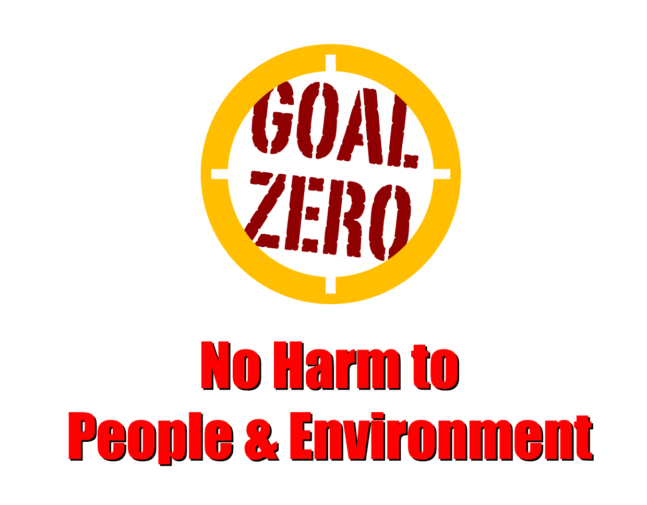
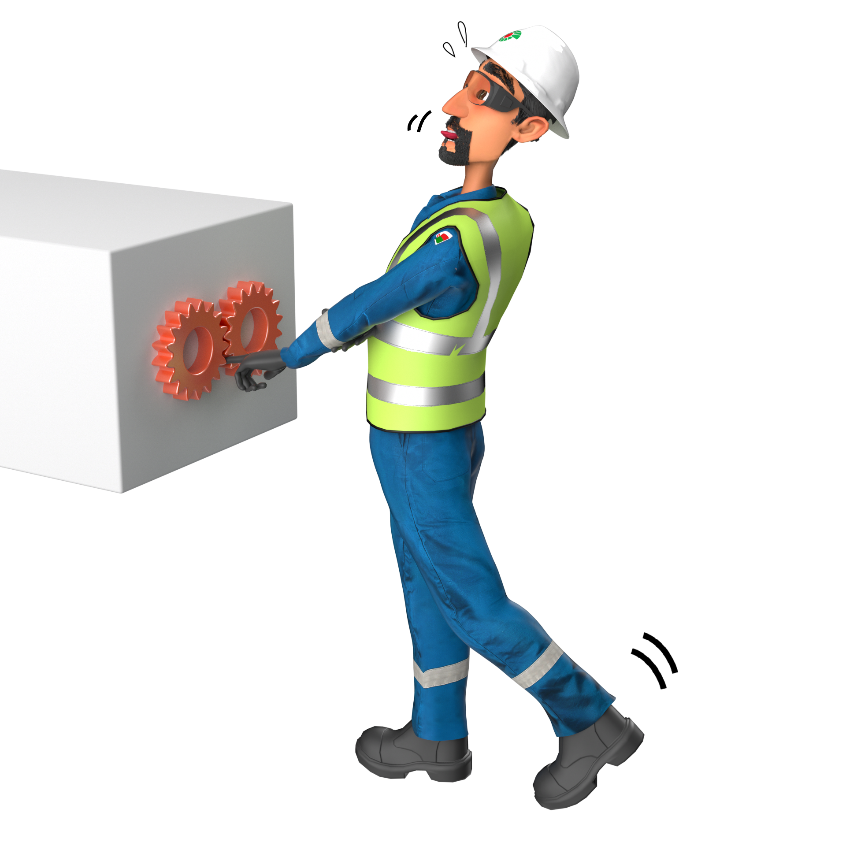
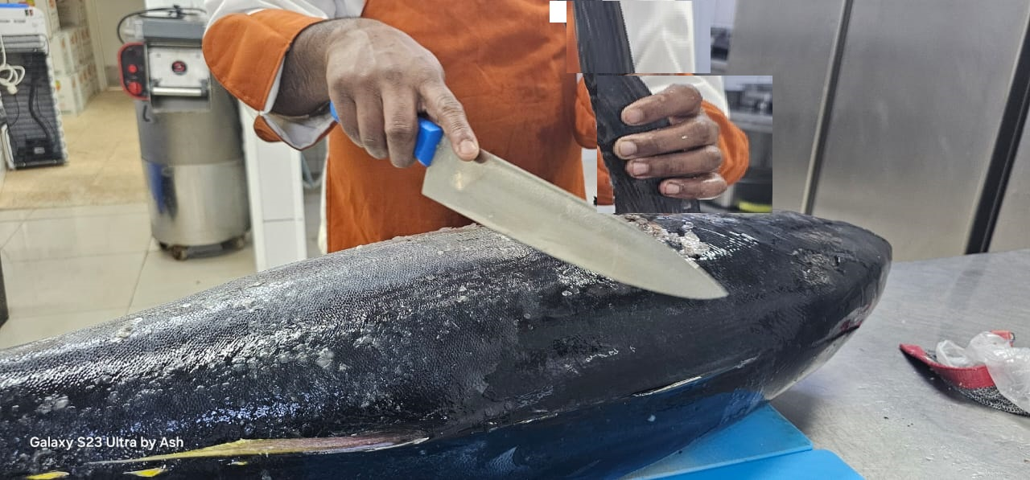
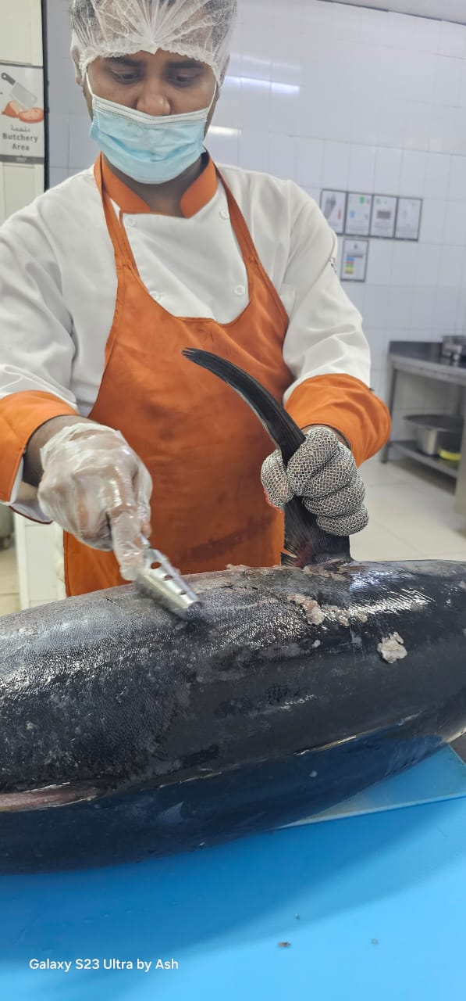
Learning From Incident - First Alert
Prevent
PIM # | 1165511 | Date & Time | 02.05.2024 17:30 PM | Location | Qarn Alam
Incident Type | LTI#07 | Category | Hands & Fingers | Activity | Preparing food.
Target Audience: All
What happened
On 2nd May 2024 at around 17:30 in WTU-15 camp, while cleaning the fish scales using a knife, one of the catering crew got a cut on his left index finger. He reported to camp clinic and the medic provided him first aid and sent him to Qarn Alam PAC clinic where he was treated for laceration to his left-hand index finger.
Initial Findings
Knife was used to scale the fish instead of a proper fish scaler.
Chain Gloves was not used by the catering crew while scaling the Fish with a knife
Engagement Questions:
How do you ensure that proper tools are available to execute the task ?
How do you ensure that people are aware of right tools and PPE required for the task?
How do you ensure that Chain gloves are used while working with sharp tools such as knives?
Always ensure to use right PPE and tools for the task
In case of an emergency please call PDO Emergency Number (Toll Free): 2467-5555
Notes:
Mr Musleh image on the top right will change according to incident pattern, MSE3 will provide you with the image as per the pattern
What happened: A short description should be provided without mentioning names of contractors or individuals. You should include, what happened, to who (by job title) and what injuries this resulted in. Nothing more!
Initial Finding: Four to five bullet points highlighting the initial main findings from the investigation. Remember the target audience is the front-line staff so this should be written in simple terms in a way that everyone can understand.
Learnings: Four to five learning message in the form of questionnaires linked with initial findings
The strap line should be the main learning point you want to get across
The images should be self explanatory, what went wrong (if you create a reconstruction please ensure you do not put people at risk) and below how it should be done.

