Slide 1
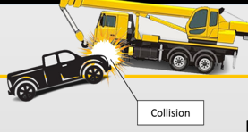
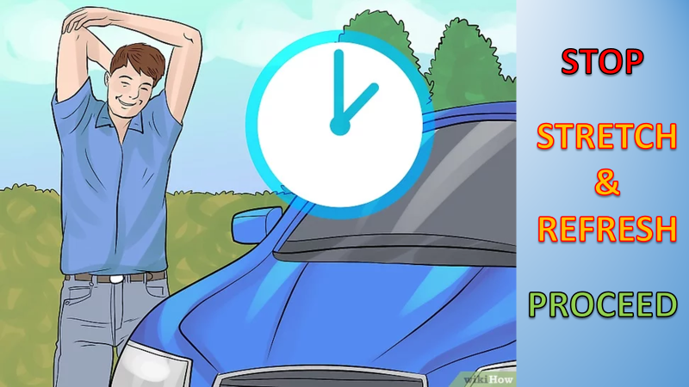
PDO Second Alert
Date:14/01/2024 Incident title: LTI#02 &LTI#03 Pattern: MVI Potential severity: C4P Activity: Driving
Target Audience: Logistics, Operation & Construction
What happened?
On 14.1.2024 at approximately 14:16hrs, a head on collision occurred between Pick up vehicle and mobile crane. The pickup was en-route from Saih Rawl towards Qarn Alam on a diversion road after delivering food to his crew members at site. At around 14:14hrs approximately 2Km away from Qarn Alam roundabout, the pickup veered onto the oncoming lane causing the front left corner of the pickup to collide with the front left corner of the crane approaching from Qarn Alam side.
X-rays revealed a compound fracture to Surveyor left arm and simple fracture to his left leg and knee. The Crane operator sustained simple fracture to his left knee. The helper (pickup passenger) was treated for minor injuries.
Why it happened/Finding :
The pickup vehicle drove onto the oncoming lane with no signs of breaking.
The pickup driver experienced micro-sleep and the passenger was asleep at the time of incident.
The journey started just after the driver had lunch.
Pick up was driving above the posted speed limit (40km/hr) on the diversion road.
Your learning from this incident.
Do you take breaks to rest when you feel tired or fatigued while driving?
Do you ensure you are aware of and adhere to road speed limits?
As a passenger, how do you remain alert to intervene in unsafe driver behaviour?
Stay alert for fatigue symptoms while driving
Notes:
Ensure all dates and titles are input
A short description should be provided without mentioning names of contractors or individuals. You should include, what happened, to who (by job title) and what injuries this resulted in. Nothing more!
Four to five bullet points highlighting the main findings from the investigation. Remember the target audience is the front line staff so this should be written in simple terms in a way that everyone can understand.
The strap line should be the main point you want to get across
The images should be self explanatory, what went wrong (if you create a reconstruction please ensure you do not put people at risk) and below how it should be done.

Slide 2
Management self audit
Date:14/01/2024 Incident title: LTI#02 & LTI#03 Pattern: MVI Potential severity: C4P Activity: Driving
Confirm the following:
Do you ensure that all the hazards and subsequent controls are covered in your HEMP regarding road related risks?
Do you ensure there is communication protocol in place for significant changes to road conditions?
Do you ensure that the Journey manager has briefed drivers about the road condition, speed limit and hazards when driving in graded road/new roads in before issuing the journey?
Do you ensure the right resources are in place during project demobilisation phase?
Do you ensure the drivers are adequately rested and not fatigued prior issuing journey management approval?
Do you ensure personnel are trained to intervene on observing any unsafe acts or conditions?
Do you have a system in place for the lateral learnings from similar incidents shared by PDO of other contractors is effectively implemented as a learning on a regular basis?
Do you ensure that all the drivers follow speed limits while driving?
Do you ensure that all drivers & journeys are tracked?
* If the answer is NO to any of the above questions please ensure you take action to correct this finding
Notes:
Ensure all dates and titles are input
Make a list of closed questions (only ‘yes’ or ‘no’ as an answer) to ask others if they have the same issues based on the management or HSE-MS failings or shortfalls identified in the investigation.
Imagine you have to audit other companies to see if they could have the same issues.
These questions should start with: Do you ensure…………………?

