Slide 1
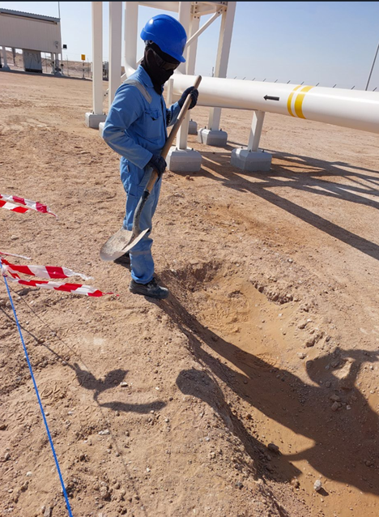
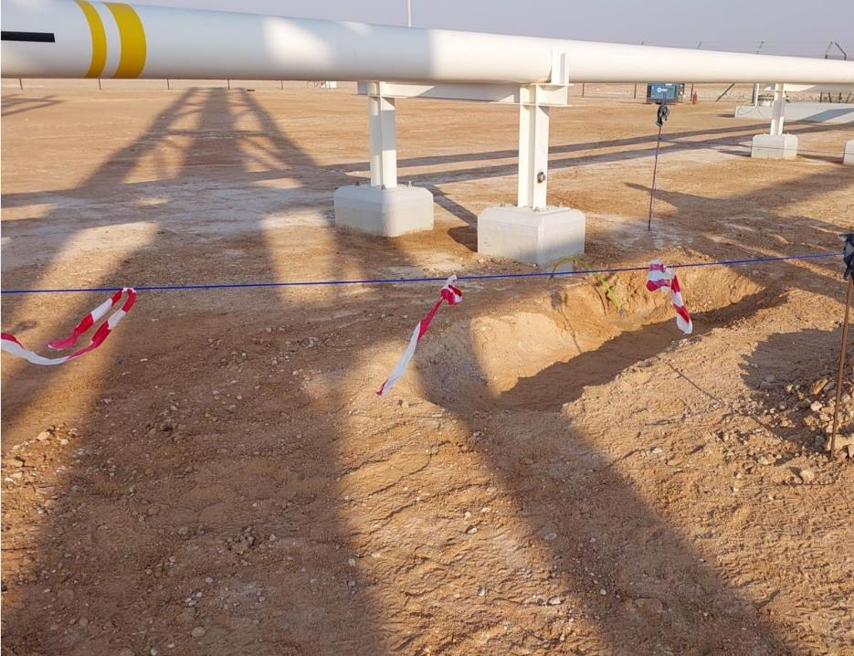
PDO Second Alert
Date: 03/01/2024 Incident title: LTI#01 Pattern: Slip, Trip & Fall Potential severity: C3P Activity: Backfilling & Soil Levelling
Target Audience: Drilling, Logistics, Operation & Construction
What happened?
On 03/01/2024 around 10:56am, at Al Huwaisah RMS 2, a Mason engaged in backfilling activity stepped on the sloppy edge of the trench in-attentively, lost balance and fell resulting in pain and swelling on his left arm. The Mason was tasked to remove stones from the trench prior to continuing with backfilling. Mason was initially sent to PDO clinic at Yibal and was subsequently sent to Nizwa for X-Ray and further treatment as advised by the PDO Doctor.
Why it happened/Finding:
IP did not follow the human kinetic practices and was placing the foot in an unsafe manner on edge of excavated area, which caused him to lose balance.
The IP failed to pay attention to his footing and surroundings which lead to loss of his balance.
The IP was performing a routine activity without conscious thought and as a result was exposed to the hazard and fell.
Your learning from this incident..
Do you ensure always be cautious of your surroundings and the hazards involved ?
Do you Ensure proper footing with regard to the surroundings to avoid losing balance.?
Make sure that all trenches have been barricaded always and never walk next to a trench to avoid falling or tripping inside it.
Stepping on the Trench edge
Avoid walking next to any trench to avoid falling or slipping inside it
Always be mindful of your steps, to avoid slips, trips and falls
Notes:
Ensure all dates and titles are input
A short description should be provided without mentioning names of contractors or individuals. You should include, what happened, to who (by job title) and what injuries this resulted in. Nothing more!
Four to five bullet points highlighting the main findings from the investigation. Remember the target audience is the front line staff so this should be written in simple terms in a way that everyone can understand.
The strap line should be the main point you want to get across
The images should be self explanatory, what went wrong (if you create a reconstruction please ensure you do not put people at risk) and below how it should be done.

Slide 2
Management self audit
Date: 03/01/2024 Incident title: LTI#01 Pattern: Slip, Trip & Fall Potential severity: C3P Activity: Backfilling & Soil Levelling
As a learning from this incident and ensure continual improvement all contract managers must review their HSE risk management against the questions asked below
Confirm the following:
Do you ensure that the hazards involved have been effectively assessed and captured in the TBT discussion prior to deploying the crew for the task?
Do you ensure the provision of safe access and egress for all parts of the work?
Do you ensure your crews use and follow safe access and egress?
Do your ensure your crews are mindful of their steps / footing to avoid slips / trips and falls?
Do you ensure that the workers are aware of their authority to stop unsafe work practices?
* If the answer is NO to any of the above questions please ensure you take action to correct this finding
Notes:
Ensure all dates and titles are input
Make a list of closed questions (only ‘yes’ or ‘no’ as an answer) to ask others if they have the same issues based on the management or HSE-MS failings or shortfalls identified in the investigation.
Imagine you have to audit other companies to see if they could have the same issues.
These questions should start with: Do you ensure…………………?

