Slide 1
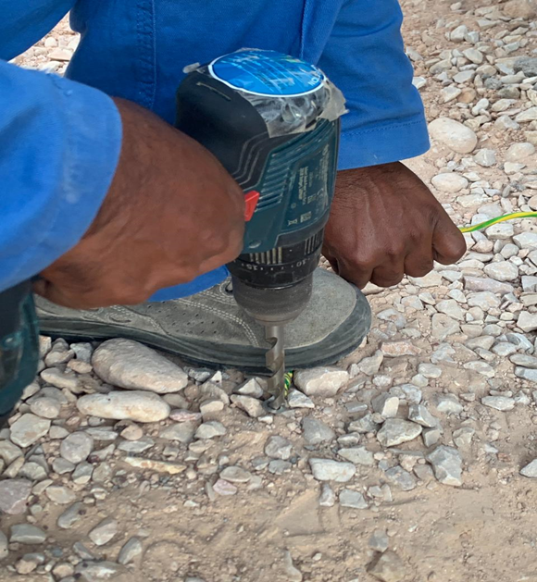
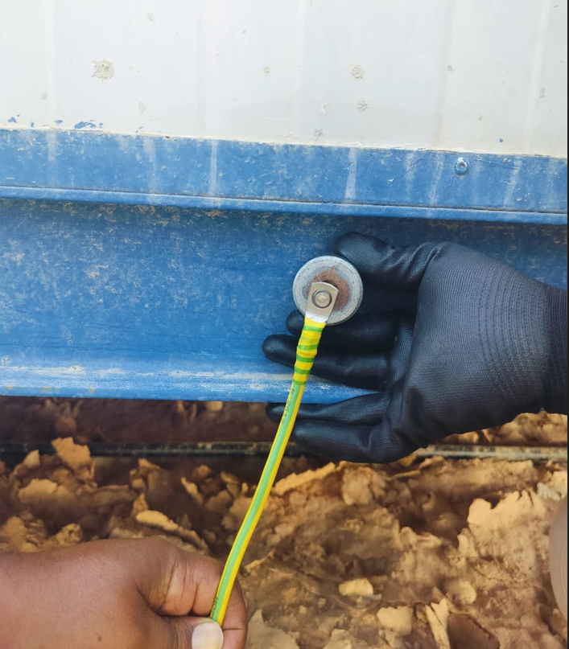
PDO Second Alert
Date: Time: | 25/09/2024 03:35 PM | Incident title: PIM# | LTI#19 1170729 | Risk Category: Injury / Asset Damaged: | Released Energy Finger injury | Actual Severity: Potential severity: | 3P C3P | Activity: Location: | Using Cordless Drill Harweel
Target Audience: All
What happened?
On 25th September 2024 around 03:35pm, a senior carpenter from camp maintenance team was trying to enlarge the hole of an earth cable's lug (8 mm), as it was not matching the earth boss stud bolt (10 mm).
The carpenter used a cordless hand drill machine with a 11.5 mm HSS drill bit and started the machine holding the cable by left hand and keeping the cable lug on the ground under his foot. When the drill machine started, immediately the cable slipped from under his foot and got pulled along with the rotation of drill bit. This resulted cut injuries to his index finger and middle finger as it got tangled between the cable and rotating bit. The employee was taken to PDO Harweel clinic immediately and was subsequently referred to Badr Al Samaa Hospital, Salalah for further management.
Why it happened/Findings:
The Carpenter took a personal decision to carry out the task, which was not assigned to him.
Using the drill to expand the cable lug hole is not an authorized activity.
Electrician brought incorrect cable lug not matching the size of earth boss stud bolt from the stores to worksite.
Materials of different sizes are stored together without adequate segregation and labelling.
Your learning from this incident..
Ensure that employees are not performing the job which is not assigned to them.
Ensure checking the size of the cable lug for its correct match prior to leaving the stores.
Ensure that all activities are performed with proper supervision and with proper Control of Work.
Enlarging the cable lug hole is prohibited as it would reduce the material integrity, potentially compromise on the strength and electrical conductivity; it was not known to the carpenter.
If a lug doesn't fit properly, crew should stop the work and seek to obtain the one with correct size rather than trying to modify the existing one.
All electrical work must only be carried out by competent electrician who must be available at site during the execution of the work.
All grounding cables must be properly checked using industry standard connectors, terminals, distribution boxes etc. before installation.
Use correct size Cable lug
ALWAYS obtain authorization before starting work!
Notes:
Ensure all dates and titles are input
A short description should be provided without mentioning names of contractors or individuals. You should include, what happened, to who (by job title) and what injuries this resulted in. Nothing more!
Four to five bullet points highlighting the main findings from the investigation. Remember the target audience is the front line staff so this should be written in simple terms in a way that everyone can understand.
The strap line should be the main point you want to get across
The images should be self explanatory, what went wrong (if you create a reconstruction please ensure you do not put people at risk) and below how it should be done.

Slide 2
Management Self-audit
Date: Time: | 25/09/2024 03:35 PM | Incident title: PIM# | LTI#19 1170729 | Risk Category: Injury / Asset Damaged: | Released Energy Finger injury | Actual Severity: Potential severity: | 3P C3P | Activity: Location: | Using Cordless Drill Harweel
As a learning from this incident and ensure continual improvement all contract managers must review their HSE risk management against the questions asked below
Confirm the following:
Do you ensure your crews have the right authorization before starting the job?
Do you ensure the crew are aware of empowerment to stop and intervene on unsafe act or condition?
Do you ensure employees are aware the hazards and risks before commencing any task?
Do you ensure employees collect the right material and that they check before leaving the stores?
Do you ensure adequate supervision in place while performing activities?
Do you ensure your employees stay away from line of fire when using rotating equipment?
* If the answer is NO to any of the above questions please ensure you take action to correct this finding
Notes:
Ensure all dates and titles are input
Make a list of closed questions (only ‘yes’ or ‘no’ as an answer) to ask others if they have the same issues based on the management or HSE-MS failings or shortfalls identified in the investigation.
Imagine you have to audit other companies to see if they could have the same issues.
These questions should start with: Do you ensure…………………?

