Slide 1
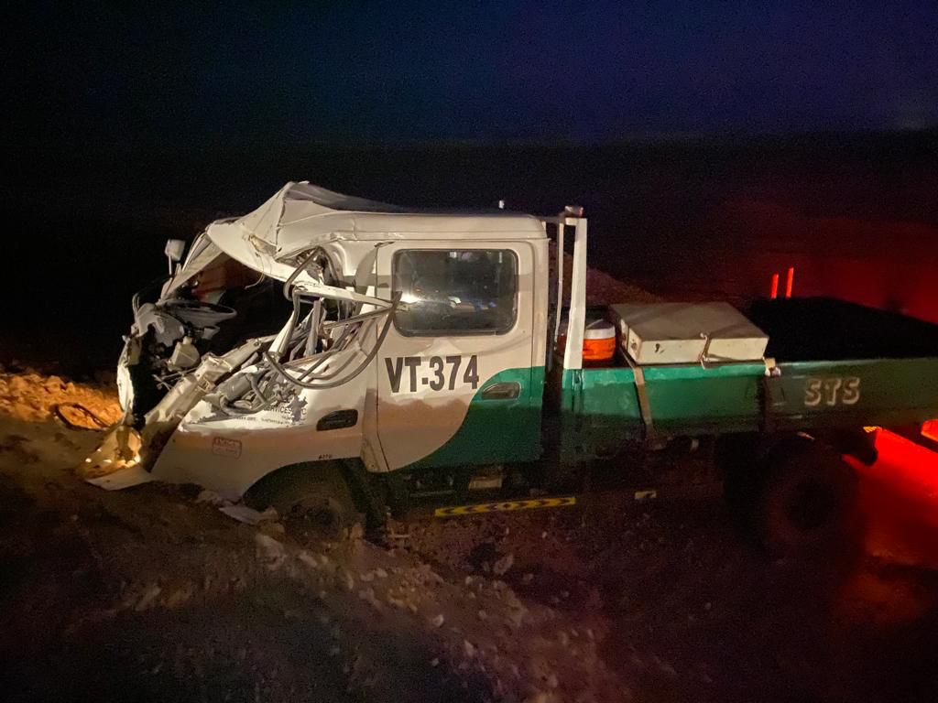
PDO Incident First Alert
Incident Type | LTI#29 | Pattern | MVI
Date / Time | 07.11.2021@18:10hrs | Directorate
Location | On road from Mabrouk to Qarn Alam | Dept
Target Audience
Drilling, Operations, Engineering & Construction
What happened
While the Driver was travelling from Mabrouk to Qarn Alam, he hit a camel on the road, lost control over the vehicle and hit on a windrow resulting in head injury.
Mr. Musleh asks the questions of can it happen to you?
Do you ensure you identify all road hazards?
Do you always apply defensive driving techniques?
Do you always ensure you and passengers wear seatbelts?
Do you always ensure your speed is within approved limit?
Please disseminate this LTI notification to your teams and use it in your tool box talks and HSE meetings and notice boards.

