Slide 1
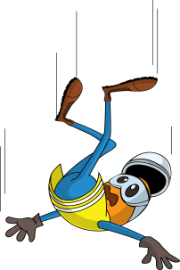
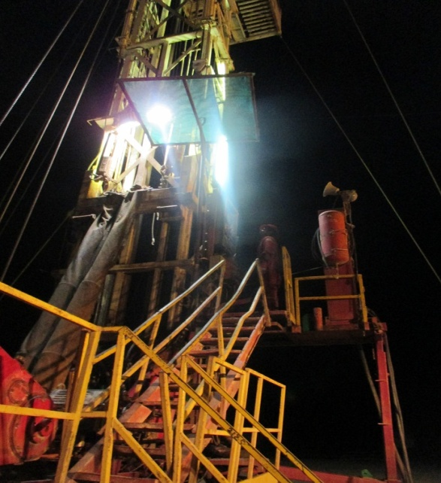
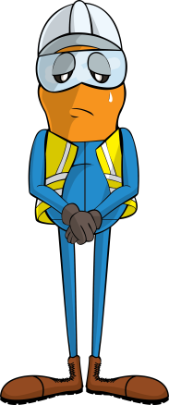
PDO Incident First Alert-
Incident type | LTI (#10) | PIM ID | 1093236
Date/ time | 01/05/2016 | Directorate
Location | Hoist 58 - Fahud | Dept
Sun shade that swung towards driller
What happened
Whilst rigging down a hoist a driller removed the sun shade on the Driller’s console. Its weight was being held above by a fork lift and as he released the last securing bolt, the shade swung and hit the driller pushing him off the platform and he fell 3.5m to the ground fracturing his pelvis and right wrist.
Mr. Musleh asks the questions of can it happen to you?
Do you always ensure you are protected from a fall from height?
Do always consider if you are in the line of fire?
Do you always ensure you are out of the lifting zone?
Driller stood on unprotected platform
Please disseminate this LTI notification to your teams and use it in your tool box talks and HSE meetings and notice boards.

