Slide 1
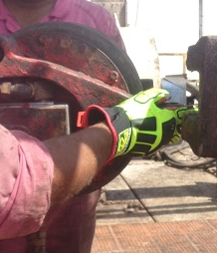
PDO Incident First Alert
Incident type | LTI (#43) | PIM ID | 1091349
Date/ time | 26/10/2015 (22:00 hrs) | Directorate
Location | Hawqa, Bahja area | Dept
What happened
Two floormen were handling a pipe spinner (suspended from above). As they attempted to move a pipe toward the mouse hole. The spinner unexpectedly swung backwards crushing one of the floormans hands between the spinner and a fixed object.
Mr. Musleh asks the questions of can it happen to you?
Do you expect the unexpected?
Do you always pay attention?
Do you always hold the handles?
Do you keep your hands out of the line of fire?
Pipe spinner
Crush point
Please disseminate this LTI notification to your teams and use it in your tool box talks and HSE meetings and notice boards.

